Slide 1

RECOMMENDER SYSTEM
INSY 5376 BIG DATA ANALYTICS
TEAM MEMBERS

Slide 2

RECOMMENDER SYSTEM

Slide 3
RECOMMENDER SYSTEM
A recommender system seeks to predict the "rating" or "preference" that a user would give to an item. It is a subclass of information filtering system.
Recommender systems have become increasingly popular in recent years, and are utilized in a variety of areas including music, movies, news, books and more.
Recommender systems typically generates a list of recommendations by either of the following – collaborative and content-based filtering.

Slide 4
RECOMMENDER SYSTEM
Content-based filtering recommend additional items with similar properties by utilizing discrete characteristics of an item.
Collaborative filtering builds a model from a user's past behavior (such as ratings given by user to the product) as well as similar decisions made by other users. This model is then used to predict ratings for items (or items) that the user may have an interest in.

Slide 5
RECOMMENDER SYSTEM
Content-based filtering recommend additional items with similar properties by utilizing discrete characteristics of an item.
Collaborative filtering builds a model from a user's past behavior (such as ratings given by user to the product) as well as similar decisions made by other users. This model is then used to predict ratings for items (or items) that the user may have an interest in.

Slide 6

RECOMMENDER SYSTEM

Slide 7
Collaborative Filtering

Slide 8
Collaborative Filtering
Collaborative Filtering is a method of making automatic predictions.
Collaborative filtering learns a user’s preference based on information of his/her engagements (ex. Ratings) with a set of available products along with his/her engagements with same set of products.

Slide 9
Collaborative Filtering
By discovering the usage patterns among users and items in data, Collaborative Filtering algorithms are able to infer user’s preferences and to use those preferences to recommend them new items which he/she would like.
CF algorithms are most widely used on e-commerce web sites, where they serve as cornerstones for their recommendation engines.

Slide 10
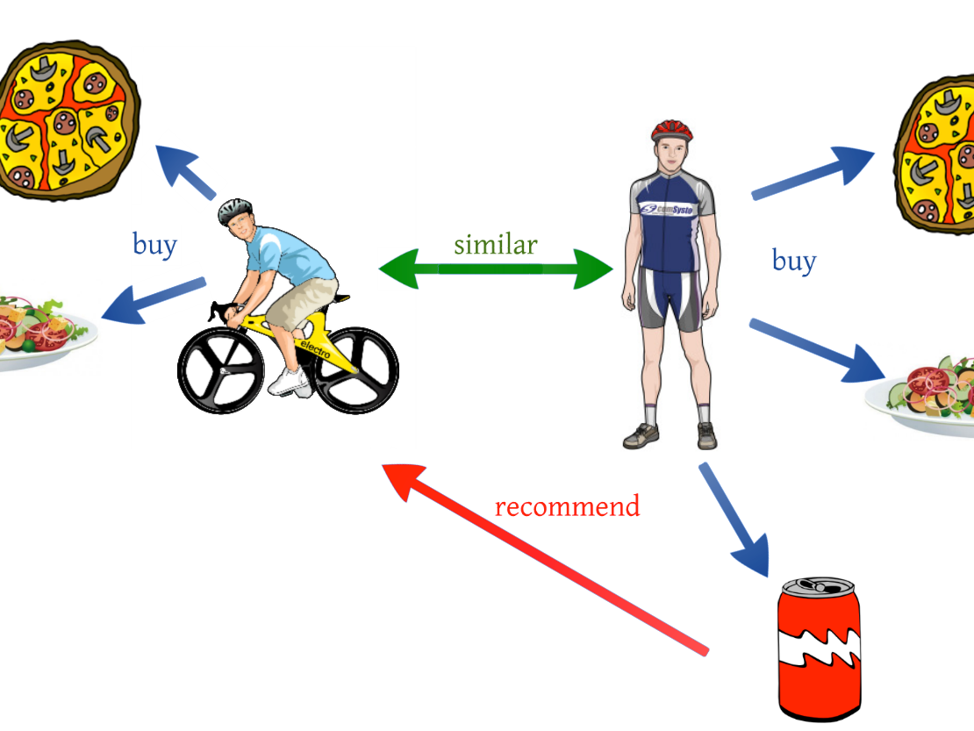
Collaborative Filtering

Slide 11
Clustering and Co-Clustering problem
clustering is the process of grouping objects based on object similarity, in such a way that objects that belong to the same group (also known as a cluster) are more similar to each other than to those in other groups.
In real world, a user rating a document is affected by both the user characteristics and the document characteristics. Often, this type of signal is represented as a matrix, of which each dimension represents one of the entity types. Co-clustering is a term in data mining that relates to a simultaneous clustering of the rows and columns of a matrix. Where classical clustering methods assume that a membership of an object depends solely on its similarity to other objects of the same type, co-clustering can be seen as a method of co-grouping two types of entities simultaneously, based on similarity of their pairwise interactions.

Slide 12
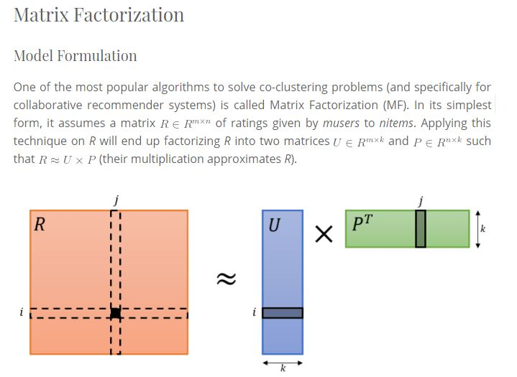
Alternating Least Squares

Slide 13
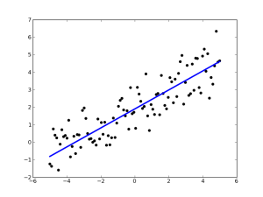
Alternating Least Squares
It is a two-step iterative optimization process. In every iteration it first fixes P and solves for U, and following that it fixes U and solves for P.

Slide 14
Alternating Least Squares
The reason why we choose Alternating least square algorithm over gradient descent algorithm because it is not a popular choice for an optimizer for MF if the dimensionality of the original rating matrix is high which is (n*k + m*k), where K is the rank of the factorization. In real life problems, this number (n*k + m*k) can get very large.
Additionally, alternating between the two steps guarantees reduction of the cost function, until convergence.
In each step of ALS the cost function can either decrease or stay unchanged, but never increase.

Slide 15
Dataset, Code and Output

Slide 16
Dataset, Code and Output
We have used the Dataset from https://movielens.org/
The data sets were collected over various periods of time.
Overall data set consist of 100,000 ratings applied to 8,570 movies by 671 users.
This Data set consist of 4 CSV files:
Ratings.csv (userId, movieId, rating, timestamp)
Movies.csv (movieId, title, genres)
Tags.csv (userId, movieId, tag, timestamp)
Links.csv (movieId, imdbId, tmdbId)

Slide 17
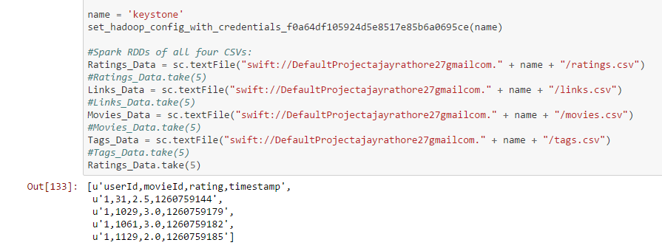
Dataset, Code and Output Data Loading

Slide 18
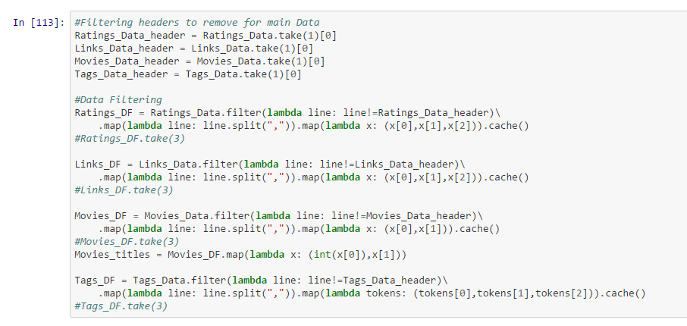
Dataset, Code and Output Filter Header

Slide 19
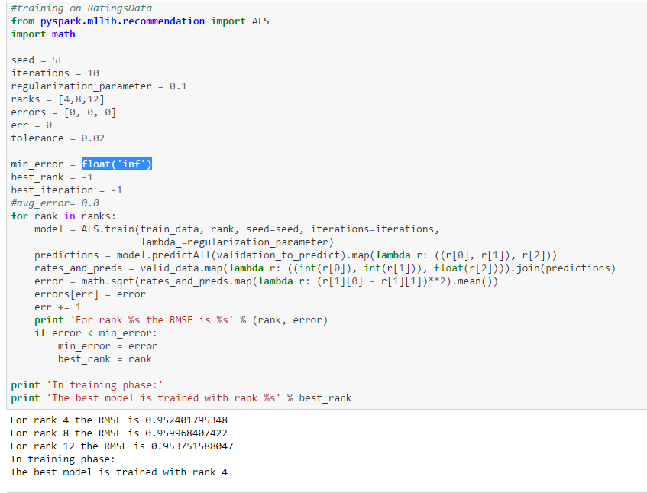
Dataset, Code and Output

Slide 20
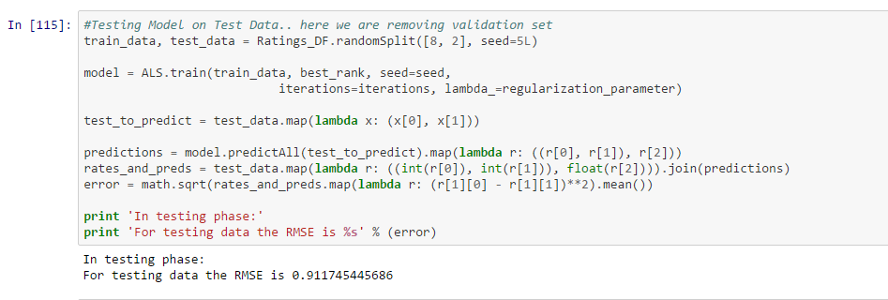
Dataset, Code and Output Testing Model

Slide 21
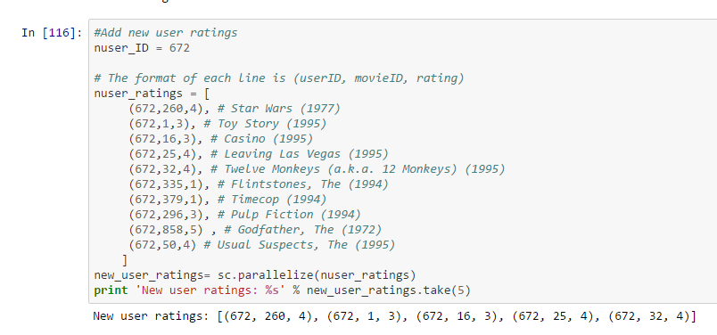
Dataset, Code and Output New user ratings

Slide 22
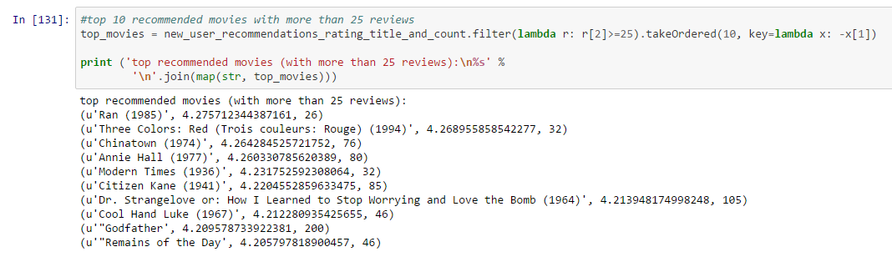
Dataset, Code and Output Recommendations

Slide 23
References
https://www.codementor.io
https://movielens.org/
https://datascience.ibm.com/
http://yos.io/2015/07/30/collaborative-filtering-with-apache-spark/

Slide 24


